Slide 1
Standard User – Contracts Editor Features: Header Tab
August, 2013

Slide 2

Learning Objectives
Upon completion of this course you will be able to:
Understand the parts of the Contract Editor Banner
Complete the information on the Header tab
NOTE: It is common for Emptoris newbies to think of a Contract as being equivalent to a Word document. This is not correct. Think of what you open in the Contract Editor as being a Contract Record, consisting of language, metadata, and other attributes. The first page of the Contract Editor, the Header tab, shows a subset of the metadata for the contract.

Slide 3
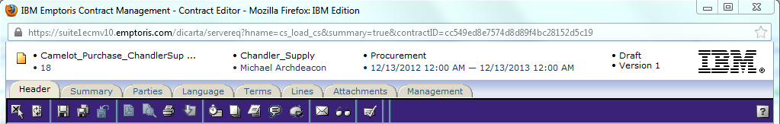
Contract Editor Banner
When a contract is opened, the Contract Editor Banner is automatically displayed and opens in the Header tab.
  Some of the information comes directly from the contract template, and other information is added during development.
The information included in the banner is (in this order):
  Contract Name: as entered when the contract was initiated
  Contract Number: automatically generated by the system
  External Party: to be defined later
  Internal Party: defaults to the Author
  Contract Class: defined by the Contract Template
  Effective Start and Effective End Date: usually defined at a later time (discussed later)
  Status: initially defaults to Draft
  Current Version number: initially set to 1

Slide 4
Contract Editor Toolbar and Tabs
The Contract Editor has several tabs and icons that you use to work on your contract. Tabs include:
Header tab: contains general information about your contract
Summary tab: displays a Management Summary; a single place to view key elements of the contract. This replaces cover sheets used for paper contracts and gives approvers a very clear summary of what the contract is about. It includes:
  Text area(s) to add additional information/summary about contract
  Terms
  Modified/replaced clauses – with or without the clause text
  Specific clauses
  Relationships
  Custom properties
  Activity – who reviewed this or who approved it
Parties: identifies the Internal Contact(s) and External Party/Parties for the contract
Language tab: contains the contract language
Terms tab: contains the variable information and values defined by the template
Lines: applied to a Purchase or Sales Agreement and contains product, price, or other information (see Admin topics)
Attachment tab: contains documents associated with your contract
Management tab: helps you manage the contract lifecycle (covered in later modules)
Notes:
NOTE: Performance tab is used in a module that COP chose not to purchase. Disregard that tab.

Slide 5

Contract Editor Toolbar Icons
The icons on the toolbar will vary depending on the context and tab that you are on.
The icons on the far left of the toolbar are always available and include:
  Close
  Refresh
  Save
  Save As
  Revert
  Print Preview
  Print Structured Data
  Download the Contract
If you hold the cursor on an icon a “tool tip” appears with the icon name.
Icons that are ‘grayed out’, such as the Revert icon in the example above, are not available in the current context.
A complete list of all icons is available in the online Help.

Slide 6
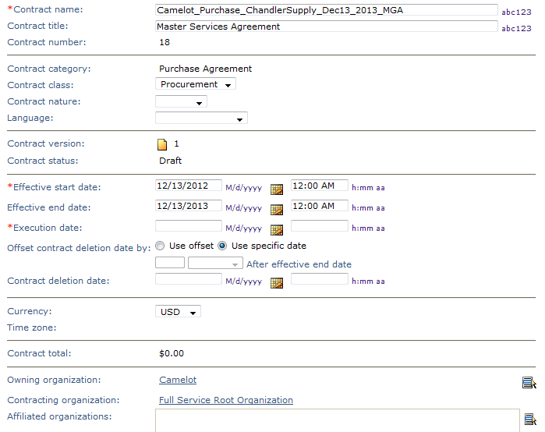
Header Tab
The Header tab of the contract is where the contract attributes are defined.
It is used to define and view the unique identifying information about the contract.
Many of the fields are populated directly from the contract template or from values you enter.
The fields with a red * asterisk are required to be completed before the contract can be executed.

Slide 7
Header Tab, cont.
To complete the information on the Header tab:
Name: Enter or edit the contract name (required field). Contract names are not unique.
Contract Title: Defined by the Contract Template, and taken from the first line of it.
Contract Number: The only unique contract identifier. It is a number generated by ECM, in ascending sequence, and numbers are never reused. ECM stores and retrieves contracts using this.
Contract Category: Selected when initiating the contract.
Contract Class: Defined by the Contract Template. The class can be edited or changed using the drop down menu.
Contract Nature: Select Regional, Local or Global from the drop down.
Language: Select the language of the Contract from the drop down menu. Setting this lets you automatically pick up clauses in that language from the repository.
Contract Version: A new Version is established when the contract is created or whenever a change is made to it after is has been presented to an outside party. ECM uses ‘Revisions’ to track changes made to contracts that have not been presented to the outside party but are being reviewed and edited internally. (The Revision number increments (once) each time a user closes the contract after changing it, even if changes were saved multiple times by that user.) For details on Versions and Revisions, see topics “Contract Versions Overview” and “Contract Revisions Overview” in the User Guide.
Contract Status: The status will remain as ‘Draft’ until the contract is presented to an outside party.
Negotiation Status: Identifies whether or not the contract has been presented to the outside party and the presentation method.

Slide 8
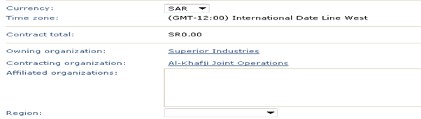
Header Tab Organizations
Currency: The contract’s currency; defaults to USD. Use the drop down menu to override.
Time Zone: Selected when initiating the contract.
Owning Organization: Business owner of the contract. Defaults to contract creator's organization.
Contracting Organization: Manages collaboration and negotiation of contract. Defaults to contract creator's organization, and when primary internal contact changes, automatically changes to his/hers.
Affiliated Organizations: Other organizations that may need to view or interact with the contract. Use the Selector icon to view available groups. (See next page)
Region: Select the region appropriate to the business from the drop down menu.
Contract Spend ID: This is a custom field and not in use at this time.

Slide 9
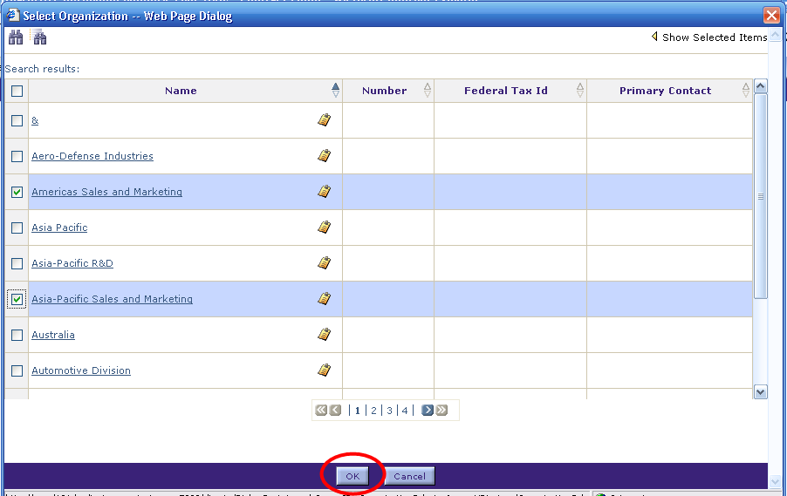
Select an Affiliated Organization
The list of organizations is displayed.
Click the check box, or click in the row to highlight each organization.
  Note: Click the small clipboard icon to display the properties (name, location, etc.) about the organization or contact.
Click the OK button to select the highlighted organizations.

Slide 10
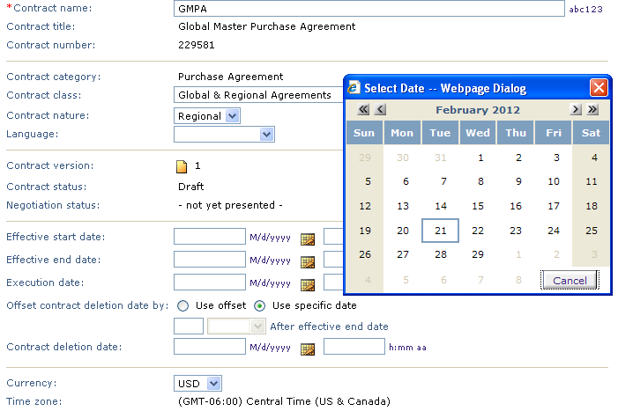
Header Tab Dates
Effective Start Date: Use the calendar icon to display and select the contract start date. This can be changed up to the time the contract becomes Active or Expired.
Effective End Date: It is common for an End Date to NOT be entered, because many contracts go on “forever”.
Execution Date: Can either be set by the user or system-driven when the contract is Executed.
Contract Deletion: This is rarely used, and is not generally recommended, because of potential legal exposures due to contracts being deleted unexpectedly (by the batch process which deletes contracts that are past their deletion date). DO NOT USE the “Offset deletion date by” option, due to particular uncertainty about when deletion will occur (if Effective End Date changes).
To enter a Date:
Click the calendar icon to the right of the date field.
Use the forward or back chevron buttons to move to the next/previous month using the single button
or the next/previous year using the double button.
Click on the date to select it.

Slide 11
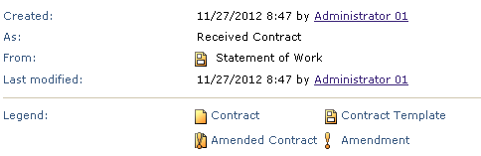
Other Header Information
Other information displayed on the Header tab includes:
  Created: Date the contract was created and the author’s name
  As: How the contract was created (e.g. authored versus imported as a file)
  From: The name of the template used to create the contract.
  Last Modified: Date, time, and author when the contract was last changed and saved.
  Using interview: The name of the interview that was used to create the contract.
  Legend: Explains the different icons that may be visible on the Header tab or on the Home Page. The icons are also used to identify the type of agreement.
Once this information is complete, you are ready to go to another Tab in the Contract Editor.

Slide 12
Contract Locking
A contract is locked when it is opened in the Contract Editor. This prevents other users from changing the contract at the same time. A lock icon is displayed beside contracts that are locked.
Once locked, the contract becomes unlocked when one of the following occurs:
  The contract lock holder closes the Contract Editor.
  A session timeout occurs.
  Anyone with Contract > Unlock > Perform permission unlocks the contract by listing it in a Search result or in a folder, then invoking the Unlock action.
Note: The locking described here is similar to, but not the same as, the locking that occurs at the Checkout of a contract. Checkout and Checkin are discussed in a later presentation.

Slide 13

Questions?

